Slide 1

Madrid 2017
5th World Congress
May 25-25, 2017
The theme “Building bridges, expanding Homeshare”
Highlights the need to bring awareness and innovative and social initiative for it to reach a greater public and to serve as a bridge between generations and cultures.
The Nan Maitland Memorial Lecture
Intergenerational Relationships for Older People
Professor Malcolm Johnson
President of Homeshare International

Slide 2
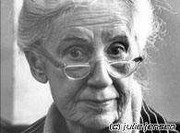
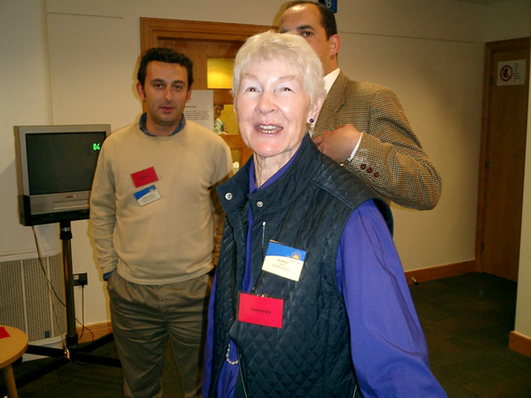
Founders
Maggie Kuhn : Founder
of the Gray Panthers
and Homeshare
Nan Maitland
Co-Founder: Homeshare International International
International

Slide 3
A challenging assignment
The title of my talk “Intergenerational relationships for older people” was fine. – It is a topic that has engaged my interest, research and writing for many years.
But I was also asked to include the following:
* Some of the history of Homeshare International
* Something about my work on Spirituality in Later Life and my concept of ‘Biographical Pain’
*Mention of my current research interests
At first I was flattered that you might be interested in the issues that interest me.
BUT HOW WAS I TO MAKE IT ALL HANG TOGETHER as an opening for our FiFth World Homeshare Congress?
and not be so dull as to add to your jetlag and send you to sleep………
What follows is an attempt to address this range of topics in a way which links with the our INTERGENERATIONAL theme.

Slide 4
HOMESHARE: Exchange of housing for help
Maggie Kuhn
Saw that intergenerational shared housing could provide a fine mixture
of mutual gift giving.
She believed profoundly in an all-age society and in positive intergenerational relations.
Nan Maitland
who was the first to take up the idea in the UK described it this way :
‘Homeshare is an exchange of housing for help – an
intergenerational program for the mutual benefit for old
and young alike. Older people give what they have to a
younger person - spare accommodation and the wisdom
accrued from a long life – in return from some practical
household help, companionship, the security of a night
time presence and perhaps a small rent.’ (2003)

Slide 5
The history of homeshare
Homeshare has its roots in the USA where the late Maggie Kuhn (founder of the Gray Panthers) set up the first programmes in 1972.
In the UK, Homeshare was taken up in the early 1980s by the late Nan Maitland, who in 1993 launched the first formal programme, in London. In Europe, it is believed that the concept of homeshare was invented quite independently in Spain, where, in 1991 the Alojamiento por Compañia programme was set up in Granada to meet an urgent need for student accommodation.
By 1992 the idea had been adopted in Germany where the award-winning Wohnen für Hilfe programme was founded by Professor Anne-Lotte Kreickemeier in Darmstadt, again to meet the need for student accommodation. There are now several programmes in Germany.
In 1999 Nan Maitland launched Homeshare International (HI) to foster the concept more widely. Homeshare programmes in Sydney and Melbourne, Australia, were launched in 2000 as a direct result of Homeshare International’s work.
In France, ensemble2générations, founded in 2006 in the Paris area, has now spread to other parts of the country. By 2013 pilot programmes were being developed in Japan, the first such programmes in Asia.
The growth of national associations
Some countries have seen the development of Homeshare associations to support programmes locally and to spearhead further development. They are:
Australia – the Homeshare Australia and New Zealand Alliance (HANZA) Germany – Wohnen für Hilfe
USA – the National Shared Housing Resource Center UK – the UK Homeshare Association is run by Shared Lives Plus

Slide 6

HI Purpose
The charity’s stated purpose is:
To advance education and promote research for the public benefit on the practice
and impact of homeshare
as a means of relieving the needs of the elderly and disabled and for the provision
of affordable housing for
those in financial need.
Homeshare International is governed by a group of Trustees who are invited
to serve by the Board.
They are drawn from many of the countries where homeshare operates
and are chosen on the basis of their
expertise as practitioners, researchers and administrators.
Members of the Homeshare Network are also invited to nominate members of the Board.

Slide 7
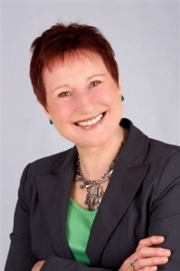
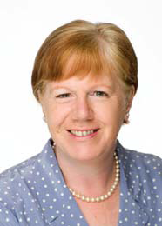
Homeshare International : Who are we?
Homeshare International was founded in London, UK, in 1999 to forge links between the homeshare programmes known to be running in eight countries and to stimulate the development of new programmes. Since then the homeshare movement has gone from strength to strength and there are now programmes in at least 16 countries.
We aim to:
provide a link between all homeshare programmes around the world, enabling the agencies involved to share information;
raise awareness of homeshare and its potential among professionals and policy makers in housing, social work and other relevant fields;
stimulate the setting up of new homeshare programmes;
support and encourage good practice in running programmes;
encourage potential householders and homesharers to join the programmes;
encourage academics to do research on the contribution that homeshare can make to the social needs it seeks to address.
Read about our progress in Homeshare International Review 2004-2013
Governance
Homeshare International is now a Charitable Incorporated Organisation registered in England and Wales (number 1170332). Until December 2016 it was a registered charitable trust and changed its status to better reflect its remit.
Homeshare International was founded in London, UK, in 1999 to forge links between the
Homeshare programmes known to be running in eight countries and to stimulate the
development of new programmes. Since then the Homeshare movement has gone from
strength to strength and there are now programmes in at least 16 countries.
We aim to:
*provide a link between all Homeshare programmes around the world,
*enabling the agencies involved to share information;
*raise awareness of homeshare and its potential among professionals and policy makers
in housing, social work and other relevant fields;
*stimulate the setting up of new homeshare programmes;
*support and encourage good practice in running programmes;
*encourage potential householders and homesharers to join the programmes;
*encourage academics to do research on the contribution that homeshare can
make to the social needs it seeks to address.

Slide 8
We believe in intergenerational solidarity. But not everyone does
Over the past 30 years the increasing complexity of the relationship of the state to its citizens and shifting notions of fairness, equity and reciprocity has caused repeated challenges to established thinking and arrangements for solidarity between the generations

Slide 9
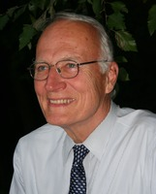
Americans for Generational Equity (AGE)
In 1985, a new organization formed in America under the leadership of Senator David Durenberger and Representative James Jones. They called it Americans for Generational Equity (AGE).
( In 1995 he pleaded guilty to charges of misuse of public funds
and was sentenced to one year of probation.)
It defined itself as a nonpartisan coalition whose mission was to build an intellectual and mass- membership movement to promote the interests of the younger and future generations in the national political process.
Its main targets were to increase the political power of young people and to reduce government expenditure on Social Security and Medicare. AGE claimed that as the elderly population grows bigger it becomes richer, demanding more costly public services and taking “more than its fair share.”
Children and young people were losing out. AGE claimed that although constituting only 11.5% of the U.S. population, those over the age of 65 consume 28% of the national budget and 51% of all government expenditure on social services.
However, the objectives were not simply fiscal.
Senator Durenberger is reported as saying, “The assumption that each working generation will take care of the one that preceded it is finished”

Slide 10
Family Responsibilities
It is simply not acceptable to observe shifts in the way relationships
unfold between adults and their parents and to characterize them as in
decline.
Too much irresponsible commentary has already placed into the
political discourse the view that the growth in the numbers and proportion
of older people is unsustainable.
Immediately following this observation
comes the cry from ideologues of the right and politicians of a timid and
populist nature that the state must step back from its commitments to
the old and poor, leaving them to the primary responsibility of their own
resources and those of their families. In turn, families are chastised for
failing in their responsibilities.

Slide 11

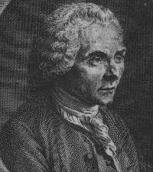

Procession of the Generations
The nature of the solidarity between individuals and within the fabric
of organized society has been the subject of philosophical examination
throughout recorded history. In modem times, we look to the formative
work of Locke and Rousseau.
John Locke
The Social Contract argued against the idea that monarchs were divinely empowered to
legislate. Rousseau asserts that only the people, who are sovereign, have that all-powerful right.
When Locke wrote of the social contract
in the late 17th century, he drew on existing concepts of popular consent.
He refined them to provide an explanation of the legitimacy of government Jean-Jacques Rousseau
and the proper relationship between governments and their subjects
in terms of the latter’s obedience.
Believing that government could only exist on the basis of consent,
Locke declared that rulers were entitled to obedience but only if their
subjects had actually consented to obey and so were committed to showing
that they had consented and voluntarily agreed, even when it looked
as if they had not. By linking consent with obligation as integral features of civil society, his writings served to fashion contemporary liberal political philosophy.

Slide 12
The Contract Between the Generations
The Procession of the Generations
The image of a procession is progressive, optimistic, and modern.
Also at risk in the intergenerational debate is another metaphor—
that of the contract.
Human societies that are not subject to totalitarian regimes are
founded on contracts, written (in law) and unwritten.
The principal ingredients are consent and trust.
There is an inescapable recognition of social exchange and reciprocity,
in those wider contracts between strangers.
The compact between the generations is not only between unknown parties but also between the dead, the living, and the unborn.
It is a moral responsibility to maintain the core of trust.

Slide 13

The pinch
“The baby boom of 1945-65 produced the wealth, baby boomers now run our country; by virtue of their biggest, richest generation that Britain has ever known.
Today, at the peak of their power and their sheer demographic power, they have fashioned the world around them in a way that meets all of their housing, healthcare and financial needs.”
David Willetts claims the baby boomer generation has attained this position at the expense of their children. Social, cultural and economic provision has been made for the reigning section of society, whilst the needs of the next generation have taken a back seat.
Willetts argues that if our political, economic and cultural leaders do not begin to discharge their obligations to the future, the young people of today will be taxed more, work longer hours for less money, have lower social mobility and live in a degraded environment in order to pay for their parents' quality of life.

Slide 14

Who are the Baby boomers?
Baby Boomers: 1946~1953 to 1964
This would make baby boomers, in the year 2017, somewhere in the range of 53-71 years old.
Gen X: 1965 to 1976~1982
This would make generation X, in the year 2017, somewhere in the range of 35-52 years old.
Gen Y: 1977~1982 to 1995~2001
This would make generation Y, in the year 2017, somewhere in the range of 16-34 years old.

Slide 15
But Intergenerational transfers still take place within families and through caring agencies
Homeshare is one exemplary provision:
We enable (usually) young and old to share living and cooking and eating.
We help to create new non-family relationships, that can blossom into deep and respectful friendships, based on reciprocity.
We help fashion cross generational bonds that have none of the complications of personal history.
These bonds can lead to the re-activating of out-of-use skills and a sense of being nee
Self esteem revives and important conversations lead to spiritual renewal.
We ensure that care and support goes both ways.
**************
I have just completed 6 weeks of filming for an intergenerational ‘experiment’ television series.
It has some of Homeshare’s magical properties

Slide 16

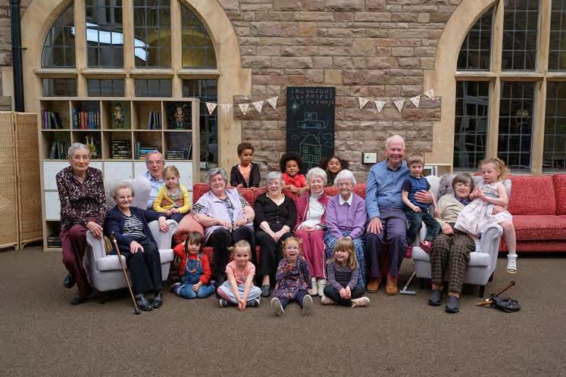
Old People’s Home for 4 Year Olds
© Channel Four 2017
Television Productions Ltd
“Social isolation is one of the biggest problems for older people in care homes, with over 60% of residents having never received a single visitor. This has a huge impact on their health, wellbeing and even life expectancy.
Based on an existing American scheme, a revolutionary new experiment for Channel 4 is going to attempt to dramatically improve this by bringing together a group of care home residents with a group of pre-schoolers.
In the brand new two part series Old People’s Home For 4 Year Olds, a team of scientists and gerontologists will bring together ten elderly care home residents and ten pre-schoolers for six weeks.”

Slide 17

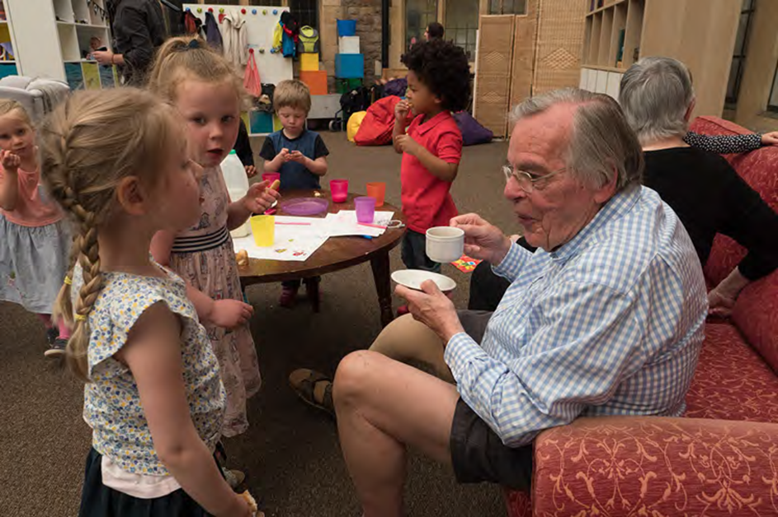
© Channel Four 2017
“The old and young volunteers will share daily activities designed by the experts who will measure and analyse the older groups’ physical and mental progress throughout.
At the end of the six week experiment the experts will hope to prove scientifically that bringing these two generations – divided by almost a lifetime – together, can transform the physical, social and emotional wellbeing of the old volunteers for the better.
Old People’s home for 4 Year Olds will be a warm, life affirming look at how the UK care home system could be revolutionised.”

Slide 18
Parameters of the 4th Age
What we know about the living circumstances of these increasingly frail older people is that two thirds of those over 75 are women (more in the higher age groups) and that two thirds of that group of women live alone; widowed or never married.
As an overlay to the cluster of chronic illnesses that will bring their lives to an end they will typically suffer severe visual impairment. Of the 1 million ‘blind’ people in the UK, 90% are late onset sufferers, principally of the unremediable condition macular degeneration. Similar proportions are severely hard of hearing.
Dementia is essentially a condition of old age the incidence of which rises steeply with age and affects women more than men. Among the over 80s around 30% (Peters,2001 in Stephan &Brayne/ Downs&Bowers, 2008) suffer from dementia.
Depression is the epidemic condition of old age.
The prevalence of incontinence is less well documented but studies show (Chrome et al Rev. Clin. Geront, 2001) levels of over one third of older people in the later stages of life.

Slide 19
New Patterns of Dying in the 4th Age
Prolonged Dwindling: Dementia
The age-standardised rate of deaths with any mention of dementia has increased 40%, from 106 per 100,000 persons in 2001 to 188 per 100,000 persons in 2014.
A higher proportion of women die with dementia compared to men and a higher proportion of deaths with dementia occur in older age groups; the average age of death for people with a mention of dementia is 86 years.
A higher proportion of women die with Alzheimer’s disease and unspecified dementia, a similar proportion of men and women die with vascular dementia.
Nearly two-thirds of deaths with a mention of dementia for people aged 65 and over occur in care homes. This is in contrast to a quarter of all deaths for people aged 65 and over.
People with dementia are less likely to die at home (8%) compared to all deaths for people aged 65 and over (21%).
Respiratory disease, circulatory disease and malignant cancers were also a mention for 38%, 36%, and 9% of all deaths with a mention of dementia, respectively. (PHE, 2016)

Slide 20
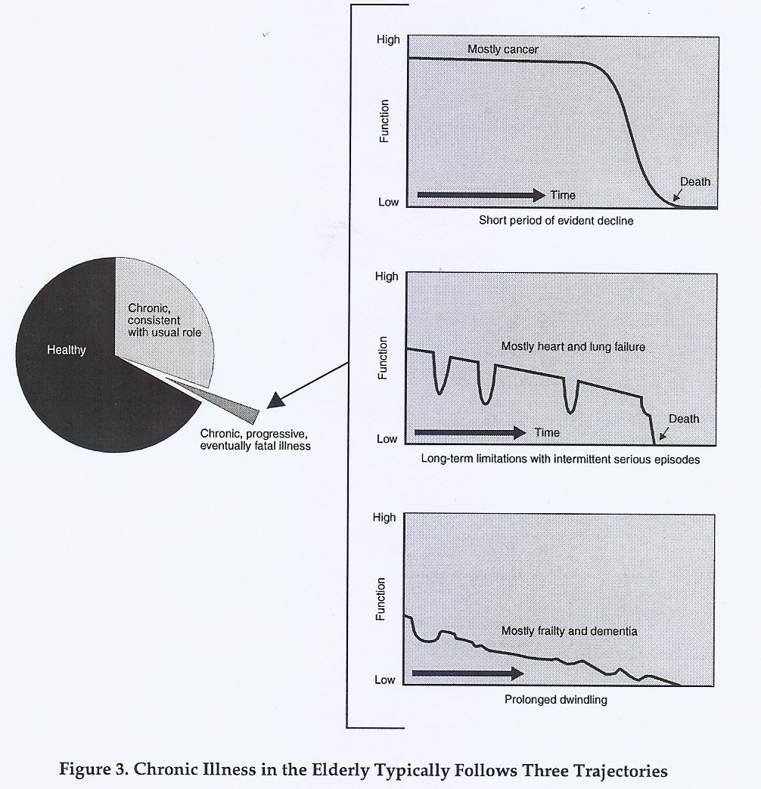

Slide 21
Biographical Pain
My research on older people at the end of life led me to understand the anguish that many experience as they face imminent death. With endless time to think, but not much time to live; there is an inescapable preoccupation with reflection about their own lives.
For some, all is harmony and contentment. But most find unconfined time for life review takes them into the deeper recesses of memory. Too often the dominant recollections are of dreadful experiences – things done by others to harm them; actions taken but deeply regretted, things always promised yet still undone.
This leisure to reflect is accompanied by disability and an incapacity to right these wrongs. So much guilt and self loathing. Some see this as unforgivable sin. Others with no belief, simply feel tortured.
Yet they rarely find a sympathetic and safe listener to relieve this profound distress :
to which I have given the name ‘biographical pain’.

Slide 22
Biographical pain in old age
Biography is the key source of spirituality
Remembering in pain is a special version of spiritual reflection for the very old and frail
Biographical pain is:
‘The irredeemable anguish, which results from profoundly painful recollection of experienced wrongs which can now never be righted.
When finitude or impairment terminates the possibility of cherished self promises to redress deeply regretted actions’.
This is an important part of the study of ageing and the lifespan.

Slide 23
Spirituality: Coming to terms with who we are
One important dimension of spirituality is the process of coming to terms with who you are and what you have done in your life, as it comes to a close.
This process of life review, given focus by psychiatrist Robert Butler 40 years ago, is essentially a spiritual enterprise.
Gerontologist, ethicist and spirituality scholar Harry Moody in his book The Five Stages of the Soul: Charting the spiritual passages that shape our lives. (Random House 1998) .
writes of ‘Standing at the Crossroads’: The first of the 5 Stages of the Soul.
“Wasn’t life supposed to get better as the years pass? Didn’t I do what I was supposed to: go to school, join the team, work hard, pay my dues?
“Now we are 34 years old. Or 40 years old. Or 59. And the years have given us neither the pleasure we assumed we’d get, nor the big payoffs we always dreamed about. Rewards and laurels may come from time to time, it’s true, but the happiness they bring doesn’t last long. There are peak moments, of course and the stretches of sunshine..
But why do they always seem over-shadowed by the gnawing sense of unfulfillment, the sameness of days?
Such experiences can bring to the fore all those unanswered questions about what you believe – or no longer believe.

Slide 24
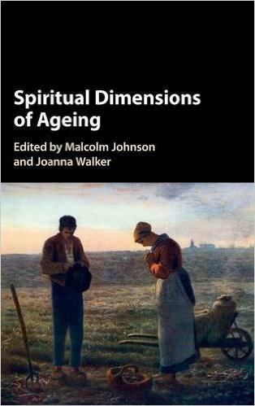

Cambridge University Press, December 2016 SCM Press 2013

Slide 25
Key questions for Homeshare
Our disposition is to provide a high quality service at a low price, for people with not much money. But must homesharing always be subsidised?
Can we find ways of persuading the public purse to meet the core costs?
Might we devise schemes where the user pays the economic rate?
What is the potential for a partly or wholly on-line homeshare system?
What skills do we need to engage governments, local governments and other major care and housing providers to adopt homeshareing as part of their essential provision?
But we do have lots of answers and good evidence.
We also have :
- A powerful and simple idea
- Solutions that fit well into a time of recession
- Decades of experience that shows that different models work in different cultures and places
Powerful values : reciprocity/intergenerational relationships/integrity/compassion/dignity and respect/low cost and high value.

