Slide 1
Homesharing: what brings us together and what can we learn from our differences

Slide 2
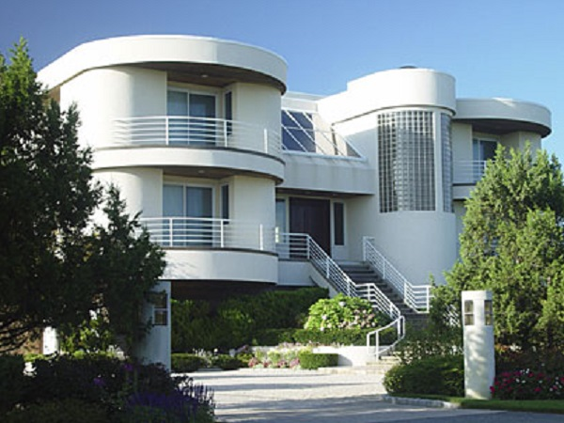
How it works ?
Homeshare organization
Notes:
Over years we have developed a proven process which ensures a successful outcome, which we describe below:
Meeting individually interested parties
Selection of pairs that correspond to criteria of one another
C) Organizing a meeting of a potentially interested pair
D) Supporting with the development and signing of an agreement between the parties
E) Management and follow-up of relationship throughout a year
Our focus is on providing a high quality service rather than run after the numbers. We work with the human beeings and each case is unique and deserves a special attention; with this in mind we promote the homesharing solution.

Slide 3
Everybody loves the concept ! lets see the details…
Notes:
Introduction student + US & Europe
Based Vermont & Belgium

Slide 4
Who runs the programs ?
Europe : mix of not-for profit organization, universities, cities…
US : not-for profit
Notes:
Where do I go to apply to the program ?

Slide 5
Who we serve
Homesharer:/ home provider
anybody in the States (average 75)
elderly people in Europe from (average 71). In Belgium, can be families.
Housemate/ home seeker
anybody in the States (very few students, average 50)
students in Europe (Belgium: average 21 and 50% foreigners)
Some programs are for disabled people or single parents (GB)
Notes:
Question from housemate candidate :
-I am interested in the homesharing concept and I would like to have more info, what “qualities” are required from both parts to participate ?
-is there any legal issues I should be informed about ?
-Is there a formal contract to sign to define both parts obligations

Slide 6
legal issues
Legal issues
Belgium (illegal work + residence)
Type of contract
Yearly in Europe
Individualized in US

Slide 7
Service/rent offered by homesharer
Rent below the average
US : $0-600/month; average $265/month
Europe (Belgium) 180€ to 350€, average 305€/month
Taylor made services
US : none to 15 hours/week; average 7 hours/week
Europe (Belgium) : none to 5 hours/week
Some organization in Europe require precise services (fully free rent in France)
Notes:
-what are the advantages from this solution for homesharer and for housemate ?
-what can be required from both part ?
-what are the limits ?

Slide 8
Duration of matches
2 weeks Trial period (US)
Contract from 1 to 10 months (Europe-Belgium), yearly renewal (75% = 10 months)
Unlimited period (US) from 3 months -17 years; average 16 months
Notes:
How long can I expect to live there ?
Finish for students

Slide 9
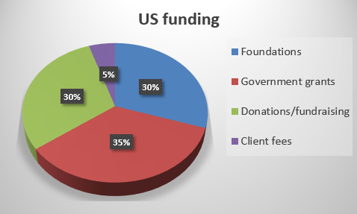
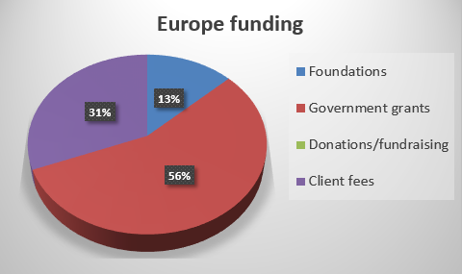
Program funding & fees
Annual fee in Europe (Belgium) only one time fee in US
Notes:
Regis is back !

Slide 10
Homesharing: What brings us all together around the world:
Common sense solution, everyone loves the concept –easy to gain public support for it
People helping each other: I offer you something, you offer me something; two people helped at the same time
Often a service component, sometimes just someone there “just in case”, or actual tasks like cooking, yard work, computer help, etc. Not just roommate who go separate ways.
Housing that is affordable.

Slide 11
Homesharing: What brings us all together around the world:
3rd party organization that provides a process of personalized screening, matching, and ongoing support
Non-profit/social purpose to the organization.
Flexible model can meet variety of needs: aging, affordable housing, persons with disabilities, etc.
It is not easy to make matches!

Slide 12
New ideas
For Europe
Develop new type of homesharing (not just students/elderly people)
Lobby towards government to simplify legal rules
Develop donation and fundraising to increase revenues
For US
More University based programs
Consider annual fees
Standardize the model to develop more programs
Notes:
Claire & Kirby

Slide 13
Questions ?

