Slide 1
Homeshare in the UK
Alex Fox, CEO
Shared Lives Plus
Chris Anderson
Director of Grantmaking
Lloyds Bank Foundation for England and Wales
From The Guardian

Slide 2
Problems, problems…
Some stubborn problems for older people:
Loneliness amongst older people
Shrinking services for people with “low level” needs
…and for younger people:
Unaffordable housing
Getting established in employment
Loneliness!
“I can see first hand how the project
has benefited my life and
that of my householder.”
Homesharer
Notes:
Most presentations start with a list of problems
Many people see our work primarily in terms of the it might fix problems

Slide 3
Seeing past problems
We don’t see that problems can also represent assets:
Home owners’/tenants’ unused spare rooms
Everyone’s capacity to help and care
Older people’s life experience
Lonely people’s capacity for new friendships
Homesharing has improved my Dad’s life hundreds
of percent and made my life more relaxed too!”
Gerald & Greg, Novus Homeshare
Householder Gerald’s Son

Slide 4
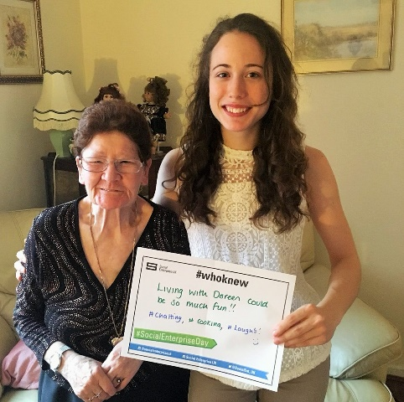
Asset-based thinking
Bringing together:
Individuals’ capacity and potential
the best of family and community life
the resources and infrastructure of services
This challenges some deeply held assumptions about:
Older and ‘vulnerable’ people
Service organisations and charities
Doreen & Anouk, PossAbilities Homeshare
Householder & Homesharer
Notes:
our members are changing people’s ideas of what is achievable, what matters and what good looks like

Slide 5
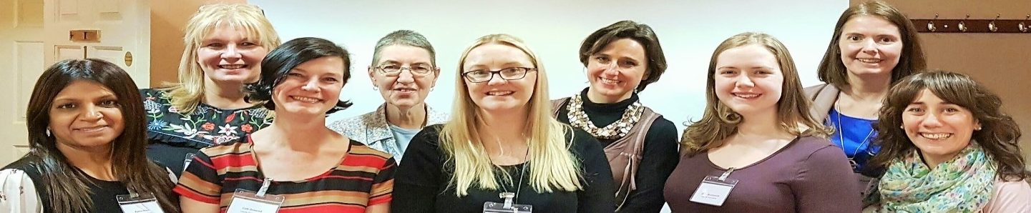
Our members
Shared Lives Plus’ members cross the boundary between home and state:
Sharing responsibility with participants, not taking it all
Supporting personal, private arrangements
So who pays? Participants and/or state?
This is not always a comfortable place to be!
Homeshare Partner
Programme Coordinators.
Notes:
our members are changing people’s ideas of what is achievable, what matters and what good looks like

Slide 6
The challenge for Homeshare
In 2014, Homeshare programmes needed to:
Define a clear role & their level of responsibility
Demonstrate safety, quality and consistency
Prove the value of their role: demonstrate impact
Become financially sustainable
Get the message about Homeshare out there consistently
Work with local and national government but at arms length
Notes:
A Homeshare scheme’s contribution is not like that of a typical service: a contribution which recognises the value of what people themselves contribute,
And it typically tapers
Relationship between what we do and the impact of Homesharing can be harder to express and pin down, or more long term

Slide 7
Homeshare Funding Programme
Part of wider national work by the Foundation in relation to enabling older people to continue to live independently
Intention is to operate a programme that funds new homeshare schemes and draws on their experience to inform future development.
Focus is on developing both a range of different approaches and a sustainable operating model
To work with a range of partners that bring different areas of knowledge and expertise
To engage an independent evaluator that also acts as a learning partner

Slide 8
Programme Aims
To fund a number of new schemes that explore the envelope of what homeshare could be
To learn by doing
To understand the routes and barriers to success
To develop sustainable operational and business models that can be replicated
To provide a range of central support through working with partner organisations
To fund wider activity that helps the homeshare sector in the UK to develop and grow
To produce a range of evidence and learning that can help influence future investment in homeshare.

Slide 9
Programme Partners

Slide 10
Programme Partner Roles
Lloyds Bank Foundation – provides £1m of funding, programme leadership, access to support form Lloyds Bank
Big Lottery Fund - provides £1m of funding, programme leadership, access to influencers
Shared Lives Plus – provides expertise on Homeshare, support to programme schemes, access to influencers
Age UK England – provides programme management, expertise on and access to older people and local providers, access to influencers
Foyer Federation – provides expertise on accommodation to younger people, access to housing providers and influencers
Social Care Institute of Excellence – provides expertise on social care, research and evaluation and access to influencers

Slide 11
Programme Evaluation and Learning
Independent evaluators, Office for Public Management (OPM), selected via competitive commissioning process
Able to adapt the as the programme develops
Provide independent evaluation and identify best practice
OPM also provide emerging findings to inform scheme development and improvement (via workshops)
Evaluation explores change over time, repeated measures, using quantitative and qualitative methods
Provide information on potential Social Return on Investment
Produce an independent evaluation report that can be used to influence support for Homeshare as a social solution

Slide 12
Progress So Far
Schemes are recruiting householders and homesharers
Initial matches being made
Web-portal up and running
Good practice guide published
Business modelling tool developed
Clear challenges identified and solutions being developed
Current environment in the UK is challenging, especially major cuts to local authority budgets
Alternatives to the existing ‘standard’ model proving especially challenging
Wider impact has been more positive, especially raising the profile of an public awareness of homeshare.

Slide 13
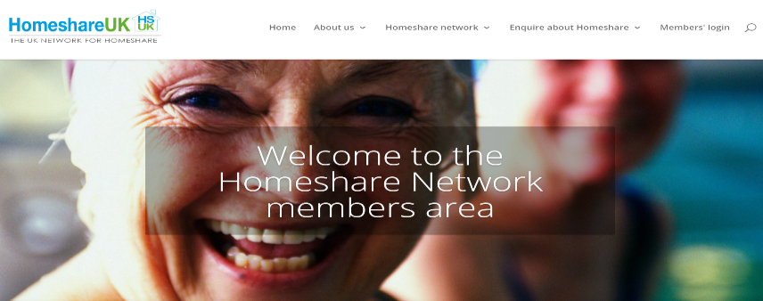
The national programme: proving safety and quality
A new Quality Assurance Framework and updated Good Practice Guide
Our team’s support: both strategic and reactive
A community of practice for practitioners
A growing library of resources
Tailored insurance cover
99% of family members report having greater peace of mind
since their relative has been Homesharing.
Homeshare UK Sector Survey, 2017

Slide 14
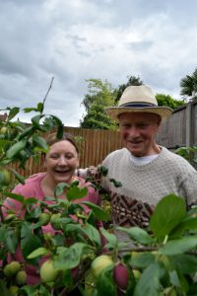
The national programme: proving impact
Data collection and analysis
The annual State of Sector report
Collecting and using stories
Partnerships with academics
An outcome measuring tool?
Fliss & Kenneth, Share & Care
“It has been brilliant for my disabled sister to have an overnight presence
in the house & some support – it’s complementary to her package of care
with visiting carers coming in the mornings”
Sister of Householder

Slide 15
The national programme: getting the message out
Telling stories
The new website: www.homeshareuk.org
Working with the national media and TV
Social media presence
Support for local media
Building support from politicians and government
“My mother has been lonely for 35 years, but no longer since she has been Homesharing.”

Slide 16
Homeshare Sector Survey 2017
812% increase in enquiries since web launch
109% increase in Householders waiting to be matched
9% growth Homeshare matches
Some learning:
Expanding start-up time frame
Benefits implications
Diversity
Attitudes
Role of Householder’s children
Notes:
812% increase in enquiries in final 4 months of reporting period i.e. since web launch Nov-March 2015-16 51 Nov-March 2016-2017 465
109% increase in HH waiting to be matched. 96 Householders this year: 46 last year. 25% reduction in waiting HS – faster churn?
9% growth Homeshare matches (250 reported active. Estimate 360).
Steady scheme growth despite 2 scheme closures.
Expanding start-up time frame. Lag getting the ball rolling. Schemes w/in larger organizations slowed by Internal bureaucracy & resistance/perceived risk aversion.
Nation growth (ROI, Scotland) ! But still gaps! Rural, South West, most Wales, NI, rest of Scot.
Impact on benefits means many are losing out. Homeshare is not as diverse as or representative of the communities It operates within.
! Problems monitoring E&D
! Opportunity for standard collection tool (^ evidence base for commissioners → dedicated referral pathways). ! Opportunity - diverse new models; target groups (gay men w/ HIV, care leavers), charging → more diverse, representative future Homeshare!
Now more than ever need investment intergen understanding –ATTITUDES of HH: negative stereotyping of young people
80% of Householder enquires made via the website have been made by family members on behalf of their parent

Slide 17
Questions for the future
How do we reframe Homeshare as a positive choice for older people, not just a form of help?
Should we see ourselves as a social movement, or part of a wider movement (e.g. against loneliness)?
How commercial should our sector become?
How best to define & defend the model?
How flexible & creative should we be?

Slide 18
Contact details
Chris Anderson
Director of Grantmaking
Lloyds Bank Foundation for England and Wales
https://www.lloydsbankfoundation.org.uk
canderson@lloydsbankfoundation.org.uk
Alex Fox OBE
Chief Executive
Shared Lives Plus
alex@SharedLivesPlus.org.uk
http://alexfoxblog.wordpress.com
@alexsharedlives

